Slide 1

IW:LEARN
TDA/SAP Training Course
Module 1: Introduction to the TDA/SAP Process

Slide 2
In this Module you will learn about….
The Global Environment Facility (GEF)
International waters in the context of GEF
Why are they so important?
The TDA/SAP Process
TDA/SAP Principles

Slide 3
Section 1: GEF and International Waters

Slide 4
What is the GEF?
Largest public funder of projects to improve the global environment
Addresses global environmental issues while supporting national sustainable development initiatives.
Provides grants for projects related to biodiversity, climate change, international waters, land degradation, the ozone layer, and persistent organic pollutants

Slide 5
What is the GEF?
Since 1991:
Provided $10.5 billion in grants
Leveraged $51 billion in co-financing for over 2,700 projects in over 165 countries
Made more than 14,000 small grants (through the SGP) directly to civil society and community based organizations, totaling $634 million

Slide 6
What are International Waters in the context of GEF?
GEF International Waters are transboundary water systems
These include:
  River basins where water flows from one country to another
  Multi-country lake basins
  Groundwater resources shared by several countries
  Large marine ecosystems (LME) bounded by more than one nation

Slide 7
Transboundary Waters….
….are water systems that are shared between more than one country
Transboundary waters cover:
Boundary water resources where the boundary between two or more sovereign states is formed by an LME, an international lake or river
Successive water resources where an international river (or underground aquifer) flows from one sovereign state to another

Slide 8
Examples:

Slide 9
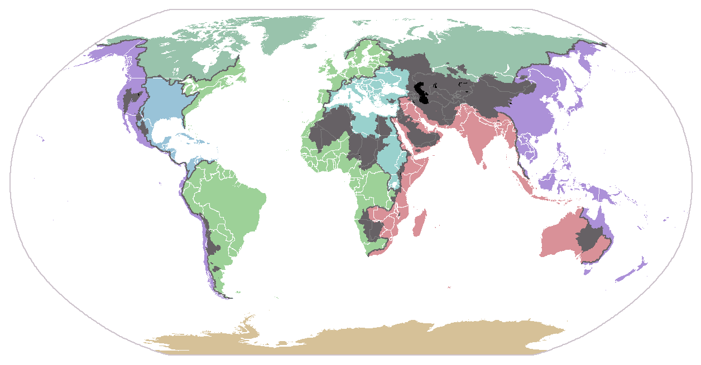
Why are they so important?
Nearly half of the world’s population is located within one or more of the 263 international drainage basins shared by two or more states
Groundwater resources account for more than 100 times the amount of surface water, and cross under at least 273 international borders
The remaining 13 basins have between 5 and 8 riparian countries
The 64 LMEs produce 95 % of the world's fish catch
The Congo, Niger, Nile, Rhine and Zambezi are shared by
between 9 and 11 countries
The Danube alone has 17 riparian nations
19 international drainage basins are shared by 5 or more riparian countries
33 countries have greater than 95% of their territory within these basins
At least 21 nations lie in their entirety within international basins
At least 145 nations include territory within international basins
Notes:
Nearly half of the world’s population is located within one or more of the 263 international drainage basins shared by two or more states.
At least 145 nations include territory within international basins.
At least 21 nations lie in their entirety within international basins
33 countries have greater than 95% of their territory within these basins
19 international drainage basins are shared by 5 or more riparian countries.
The Danube alone has 17 riparian nations.
The Congo, Niger, Nile, Rhine and Zambezi are shared by between 9 and 11 countries.
The remaining 13 basins have between 5 and 8 riparian countries.
The 64 LMEs produce 95 % of the world's fish catch

Slide 10
Section 2: The TDA/SAP Process

Slide 11
What are the Acronyms?

Slide 12
So what’s the TDA/SAP Process?

Slide 13
So what’s the TDA/SAP Process?
The Analytical Component
Transboundary Diagnostic Analysis (TDA)
Technical Analysis of Problems, Impacts, Causes
The Strategic Component
Strategic Action Programme (SAP)
Strategic Thinking, Planning and Implementation

Slide 14

TDA – The Analytical Component
The main technical role of a TDA is to identify, quantify, and set priorities for environmental problems that are transboundary in nature.

Slide 15
The TDA should aim to:
Identify & prioritise the transboundary problems
Analyse the environmental impacts and socio-economic consequences of each problem
Transboundary Diagnostic
Analysis
Analyse the causes for each problem
Analyse the institutions, laws, policies and projected investments

Slide 16
The TDA – Analysis and Engagement
The TDA provides the factual basis for the strategic component of the TDA/SAP Process – strategic thinking, planning and implementation of the SAP
The TDA should also be part of a process of engagement and consultation with all the key stakeholders from the initial TDA steps through to the subsequent development of alternative solutions during the formulation of the SAP

Slide 17

SAP – The Strategic Component
The SAP is a negotiated policy document that should be endorsed at the highest level. It establishes clear priorities for action to resolve the priority problems identified in the TDA

Slide 18
The SAP has 3 key Steps
Strategic Thinking:
The collaborative development of the key components of the SAP - Vision, Goals Opportunities for Innovation; Options and Alternatives
Strategic Planning:
National and regional consultation processes; setting strategies for implementation; action planning; developing the draft action plan
Implementation:
Endorsing the SAP; key implementation steps

Slide 19
The SAP – Key Elements
A well-defined baseline enables a clear distinction between actions with purely national benefits and those addressing transboundary concerns with global benefits.
The development of institutional mechanisms at the regional and national levels for implementing the SAP
Monitoring and evaluation procedures to measure effectiveness of the outcomes of the process.

Slide 20
Section 3: TDA/SAP Principles

Slide 21
Over-Arching Principles of the TDA/SAP Approach
Adaptive Management
Stakeholder consultation and participation
The Ecosystem Approach
Climate Variability and Change
Sustainable Development
Gender Main-streaming
Poverty Reduction

Slide 22
Adaptive Management…..
…..can be defined as a systematic, rigorous approach for deliberately learning from management actions with the intent to improve subsequent management policy or practice.

Slide 23
Adaptive Management

Slide 24
Key Principles of the TDA/SAP Approach
Adaptive Management
Stakeholder consultation and participation
The Ecosystem Approach
Climate Variability and Change
Sustainable Development
Gender Main-streaming
Poverty Reduction

Slide 25
The Ecosystem Approach….
…..is a strategy for the integrated management of land, water and living resources that promotes conservation and sustainable use in an equitable way, and which recognises that people with their cultural and varied social needs, are an integral part of ecosystems.

Slide 26
IUCN Implementation Steps
Identifying main stakeholders defining the ecosystem area, and developing the relationship between them
Characterizing the structure and function of the ecosystem, and setting in place mechanisms to manage and monitor it
Identifying the important economic issues that affect the ecosystem and its inhabitants
Determining the likely impact of the ecosystem on adjacent ecosystems
Deciding on long-term goals, and flexible ways of reaching them

Slide 27
Key Principles of the TDA/SAP Approach
Adaptive Management
Stakeholder consultation and participation
The Ecosystem Approach
Climate Variability and Change
Sustainable Development
Gender Main-streaming
Poverty Reduction

Slide 28
Sustainable Development…..
……is development that meets the needs of the present without compromising the ability of future generations to meet their own needs
Brundtland Report, 1987

Slide 29
Sustainable Development
Sustainable development underpins all GEF IW Projects
The goal of the GEF International Waters focal area is the promotion of collective management for transboundary water systems and subsequent implementation of the full range of policy, legal, and institutional reforms and investments contributing to sustainable use and maintenance of ecosystem services

Slide 30
Key Principles of the TDA/SAP Approach
Adaptive Management
Stakeholder consultation and participation
The Ecosystem Approach
Climate Variability and Change
Sustainable Development
Gender Main-streaming
Poverty Reduction

Slide 31
Poverty Reduction
It is an aim of the TDA/SAP Approach to actively encourage poverty reduction or alleviation practices to be incorporated into the SAP development process to reduce the level of poverty in communities, regions and countries.

Slide 32
Key Principles of the TDA/SAP Approach
Adaptive Management
Stakeholder consultation and participation
The Ecosystem Approach
Climate Variability and Change
Sustainable Development
Gender Main-streaming
Poverty Reduction

Slide 33
Gender Mainstreaming…..
……is 'a strategy for making women's as well as men’s concerns and experiences an integral dimension of...the policies and programmes in all political, economic and societal spheres so that women and men benefit equally and inequality is not perpetuated.’
UNESC, 1997

Slide 34
Key Principles of the TDA/SAP Approach
Adaptive Management
Stakeholder consultation and participation
The Ecosystem Approach
Climate Variability and Change
Sustainable Development
Gender Main-streaming
Poverty Reduction

Slide 35
Climate Change and Variability….
….is a significant driver (or root cause) of a number of transboundary problems in international waters – both currently and into the future
The effects of climate change (in terms of cause and impact) need to be well understood during the TDA/SAP process to ensure that future interventions in GEF international waters projects are both resilient and adaptive.

Slide 36
Key Principles of the TDA/SAP Approach
Adaptive Management
Stakeholder consultation and participation
The Ecosystem Approach
Climate Variability and Change
Sustainable Development
Gender Main-streaming
Poverty Reduction

Slide 37
Stakeholder Consultation and Participation
Stakeholders are any party who may - directly or indirectly, positively or negatively – affect or be affected by the outcomes of projects or programs.
Consequently, a wide range of stakeholders are involved in the TDA/SAP process. They can range from the Government, regulatory agencies, businesses, communities, civil society and NGOs.

Slide 38






Stakeholder Consultation and Participation
Identify relevant stakeholders
Share information with them
Listen to their views
Involve them in processes of development planning and decision-making
Contribute to their capacity-building
Empower them to initiate, manage and control their own self-development

Slide 39
Key Management Principles of the TDA/SAP Approach
Collaboration
Government Commitment
Stepwise consensus Building
Donor Partnerships
Transparency
Inter-sectoral Policy Building
Accountability

Slide 40
Collaboration
the TDA/SAP process should fully collaborate and integrate with other national, regional and international approaches, processes, initiatives or plans that have been, or are being developed for the water system.

Slide 41
Collaboration
Integrated Water Resource Management (IWRM)
The Large Marine Ecosystem (LME) Approach
Integrated Coastal Management Processes
River Basin Management Plans
International conventions and non-mandatory standards

Slide 42
Key Principles of the TDA/SAP Approach
Collaboration
Government Commitment
Stepwise consensus Building
Donor Partnerships
Transparency
Inter-sectoral Policy Building
Accountability

Slide 43
Stepwise Consensus Building
To ensure an effective TDA/SAP Process, there is a requirement to build consensus at every step.
By including clear stakeholder representation at all stages, consensus-building is more likely, increasing the probability that the outcome will be “owned” by the stakeholders and sustainable in the long-term.

Slide 44
Key Principles of the TDA/SAP Approach
Collaboration
Government Commitment
Stepwise consensus Building
Donor Partnerships
Transparency
Inter-sectoral Policy Building
Accountability

Slide 45
Transparency
The TDA/SAP process will be in the public domain so stakeholders should agree to freely share the necessary information and information products, taking care that full recognition is given to information sources

Slide 46
Key Principles of the TDA/SAP Approach
Collaboration
Government Commitment
Stepwise consensus Building
Donor Partnerships
Transparency
Inter-sectoral Policy Building
Accountability

Slide 47
Accountability
Parties committing themselves to implementing the SAP must be fully accountable for their actions.
Stakeholder groups, sectors and government agencies responsible for implementing the actions proposed within the SAP must be clearly and unambiguously identified.

Slide 48
Key Principles of the TDA/SAP Approach
Collaboration
Government Commitment
Stepwise consensus Building
Donor Partnerships
Transparency
Inter-sectoral Policy Building
Accountability

Slide 49
Inter-sectoral Policy Building
Solutions should be cross-cutting throughout the decision-making process in different sectors and at different levels.
In order to develop a pragmatic SAP, direct participation of all key sectors involved in the transboundary problems should be encouraged to ensure inter-sectoral policies are developed, when necessary

Slide 50
Key Principles of the TDA/SAP Approach
Collaboration
Government Commitment
Stepwise consensus Building
Donor Partnerships
Transparency
Inter-sectoral Policy Building
Accountability

Slide 51
Donor Partnerships
The TDA/SAP process is designed to build partnerships between development partners (donors) in order to address the identified problems and, where necessary, to assist governments to cover the costs of baseline actions.
An effective donor partnership will act as an incentive for commitment to the SAP and avoid duplication of efforts by the donor community.

Slide 52
Key Principles of the TDA/SAP Approach
Collaboration
Government Commitment
Stepwise consensus Building
Donor Partnerships
Transparency
Inter-sectoral Policy Building
Accountability

Slide 53
Government Commitment
Endorsement
of the SAP as a binding agreement between governments should be an important management objective of the process
A SAP
that does not involve a high level of formal commitment is unlikely to be taken seriously as a roadmap for policy development
and implementation

Slide 54
To Summarise
GEF International Waters are transboundary water systems that include river basins, lake basins, groundwater resources, large marine ecosystems (LME)
Transboundary waters are water systems that are shared between more than one country
TDA/SAP is a strategic process developed for transboundary water systems
The main technical role of a TDA is to identify, quantify, and set priorities for environmental problems that are transboundary in nature
The SAP is a negotiated policy document that should be endorsed at the highest level. It establishes clear priorities for action to resolve the priority problems identified in the TDA

Slide 55
Group Exercise
In groups of 5:
Why is your water system regionally and globally important? List the key points.
Timing: 15 minutes

