Slide 1

IW:LEARN
TDA/SAP Training Course
Module 2: Development of the TDA

Slide 2
Section 10: Governance Analysis

Slide 3
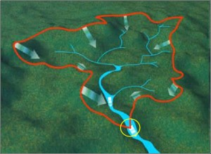

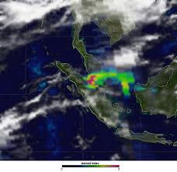

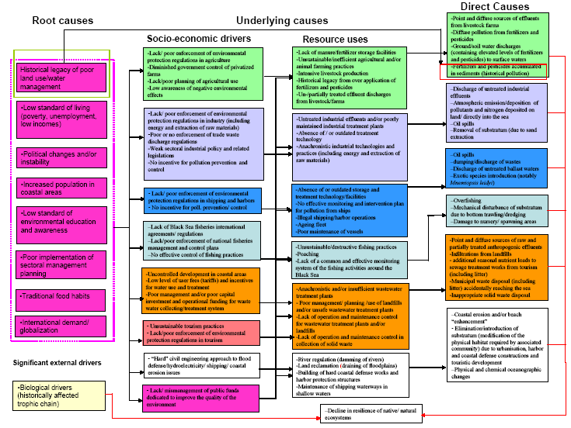
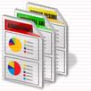
Where are we?
Defining system boundaries
Collection
and analysis of data/information
Identification
&
prioritisation
of the transboundary problems
Determination of the
impacts of each priority problem
Analysis
of the immediate, underlying, and root causes for each problem
Development of thematic reports

Slide 4
In this Section you will learn about….
What is Governance?
What is Governance Analysis?
A process for carrying out Governance Analysis
Governance Analysis for your aquatic system
Advice from the field

Slide 5
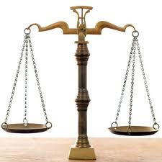
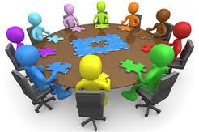

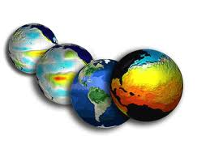
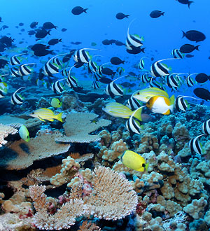
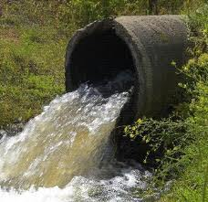
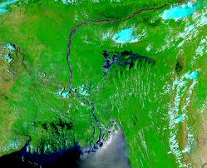
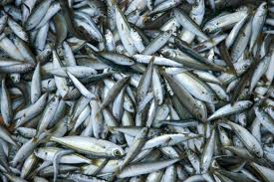
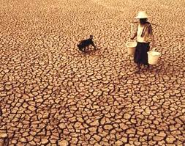
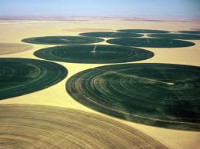
Broader studies on aspects of the TDA
Governance
Analysis
Stakeholder
Analysis
Causal Chain
Analysis
Gender
Analysis
Climate
Change
Specific reports on transboundary problems
Biodiversity
Pollution
Flooding
Fisheries
Drought
Water use

Slide 6
What is Governance?
Governance means the process of decision-making and the process by which decisions are implemented (or not implemented)
The challenge for all societies is to create a system of governance that promotes, supports and sustains human development - especially for the poorest and most marginal

Slide 7
Three Key Mechanisms
Economic
Decision-making processes that affect a country's economic activities
Political
Decision-making to formulate policy and regulation
Civil Society
Cooperation among individuals and between groups of individuals- e.g. NGO’s
Governance

Slide 8
What is Governance Analysis?
Governance analysis should examine key aspects of the processes of governance (political, economic, civil society)
In particular it should focus in on the dynamics of these relationships

Slide 9
What is Governance Analysis?
There is no agreed blueprint for governance analysis in the TDA/SAP Approach
The type of governance analysis used will always reflect the cultural, political and social structure of the countries where it is being carried out
Furthermore, it will differ between different water systems – what is appropriate for river basins will not be appropriate for LMEs and vice versa

Slide 10
Economic arrangements
      Decision-making processes that affect a country's economic activities and its relationships with other economies
      Budgetary allocations
      Relevant investments (both national and international)
Political and decision-making arrangements
      Institutional structures
      Political structure of the countries involved - including electoral processes & representation systems
      Institutional frameworks – key government departments and regulatory agencies including the dynamics between the different branches
      Policy, legislative and regulatory frameworks
      Policy, legislative and regulatory frameworks - including the process of decision-making to formulate policy and regulation at the local, sectoral, national and regional level
      Current development plans and policies, again at local, sectoral, national and regional levels
Civil society arrangements (including non governmental institutions)
      Key businesses and corporations
      Networks within civil society
      Key NGO’s and special interest groups
      Trade groups
      Community groups

Slide 11
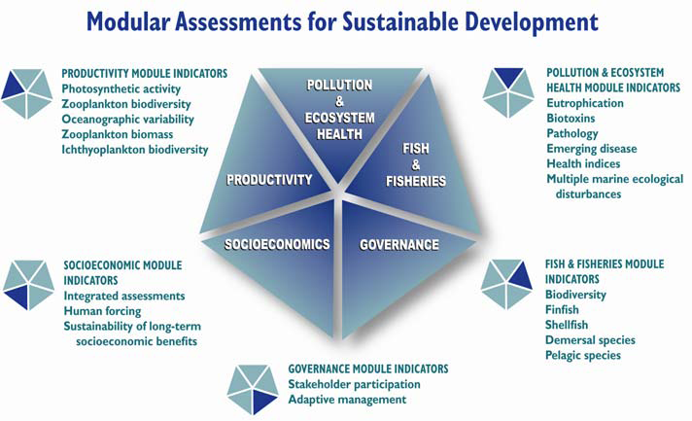
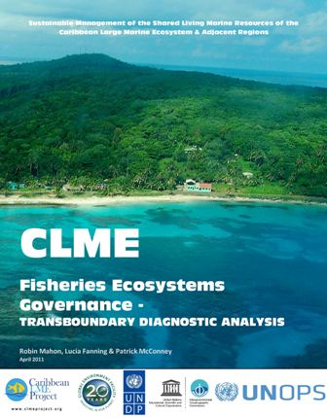
LME Approach: Governance Analysis

Slide 12
Ground and Surface Waters: Governance Analysis

Slide 13
Advice from the Field…..
Use existing assessments - International or regional organisations (UNDP, World Bank, regional development banks), universities, research institutes, NGOs, and private sector consultancies
Try to go beyond the formal aspects of political and social interaction - Don’t just describe the formal decision-making hierarchy but find out where decisions are really taken, and by whom, and why
Attend coordination meetings at key ministries or agencies in order to observe the dynamics – the informal ‘rules of the game’
Talk with in-house journalists at key ministries, and to journalists who cover political and sectoral areas.
Identify long-time and former staff members - interview them; often this is where the real institutional memory is deposited, the knowledge of what was done when, what worked and what did not – and why;

